Slide 1

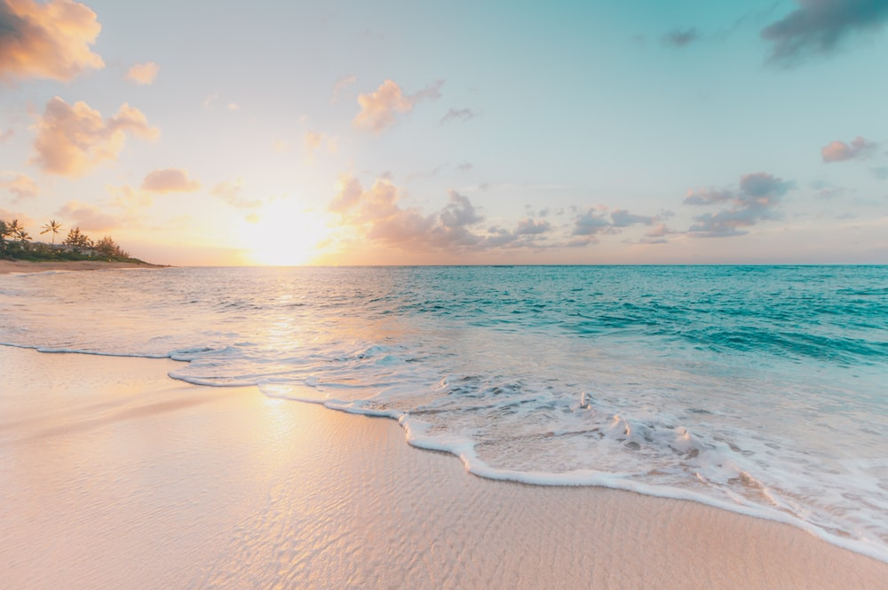
Philippine Beaches (E-magazine)
By: Shaira De Leon Honrejas

Slide 2
Philippines is home of Beautiful Beaches
This is all about the beaches in the Philippines and why it is called home of beautiful beaches. It will show not just the popular beaches in the Philippines but also the hidden beaches.
The target end user of this e-magazine are those people that are beach lover and not just Filipinos but also other people outside of the country that are planning to have a vacation and enjoy the white sands, crystal clear water and beautiful views.
The Objectives of this project are:
The design will catch the attention of the user
The user will see what they want to see
It is easier to navigate

Slide 3
Timeline / Goals
To do | Estimated Date of Completion
Proposal | Feb 11, 2023
Design and Code for Cover | Feb 14, 2023
Design and Code for Home | Feb 16, 2023
Design and Code for Destination | Feb 18, 2023
Design and Code for Travel | Feb 20, 2023
Design and Code for Activities | Feb 22, 2023
Design and Code for News | Feb 24, 2023
Design and Code for Contact Us | Feb 26, 2023
Project Presentation | Feb 27. 2023

Slide 4
